Slide 1

.NET Framework
DAY-1 Training

Slide 2
INDEX
1.Benefits
2.Dot NET Framework
3.CLR & Services
4.Frameclass Library
5.Microsoft ADO.NET
6.Microsoft ASP.NET

Slide 3
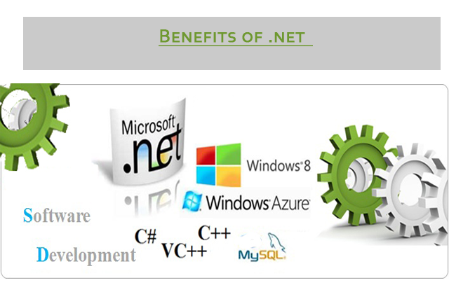
1.Single version of executable code for for all platforms. 2.The .NET framework includes a class library that is shared by all languages. 3.Full implementation and support of object oriented principles.
BENEFITS

Slide 4
.net Framework
1.It is used to develop applications of web, windows, phone.
2.It provides broad range of functionalities and support.

Slide 5
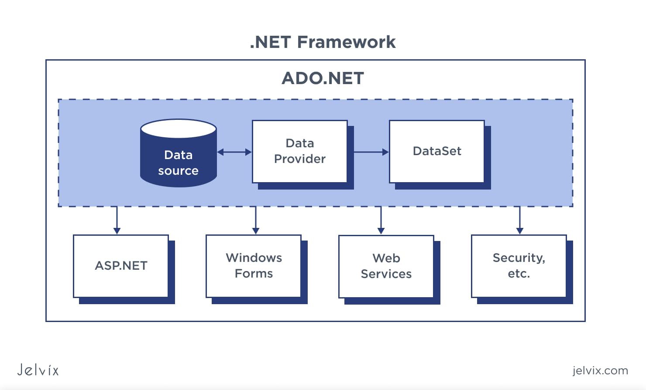

Slide 6
CLR
1.Software programs written in .NET are executed in the execution environment providing.

Slide 7
Services of CLR
1.Memory Management
2.Networking
3.Security

Slide 8
Frameclass library
1.Classes grouped into logical collections called namespaces like System.IO
2.Classes grouped into physical collections called assemblies like System.IO.dll

Slide 9
Microsoft ADO.NET
1.It is used to establish a connection between application and data sources.
2.Supports for XML

Slide 10
Microsoft ASP.NET
1.It is easy to create Web applications as it is to create windows applications.
2.It provides a fantastic integration of HTML,CSS and JavaScript

Slide 11


